Slide 1

STOCK PRICE PREDICTION
Submitted to:-
Md Farmnuel Haque
(Technical Trainer)
GLA University Mathura
Submitted by:-
Ritika Pandey(201500579)
Vishesh Srivastava(200500800)

Slide 2
Problem Statement
The stock market appears in the news every day. You hear about it every time it reaches a new high or a new low. The rate of investment and business opportunities in the Stock market can increase if an efficient algorithm could be devised to predict the short term price of an individual stock.
Previous methods of stock predictions involve the use of Artificial Neural Networks and Convolution Neural Networks which has an error loss at an average of 20%.
we will see if there is a possibility of devising a model using Recurrent Neural Network which will predict stock price with a less percentage of error. And if the answer turns to be YES, we will also see how reliable and efficient will this model be.

Slide 3
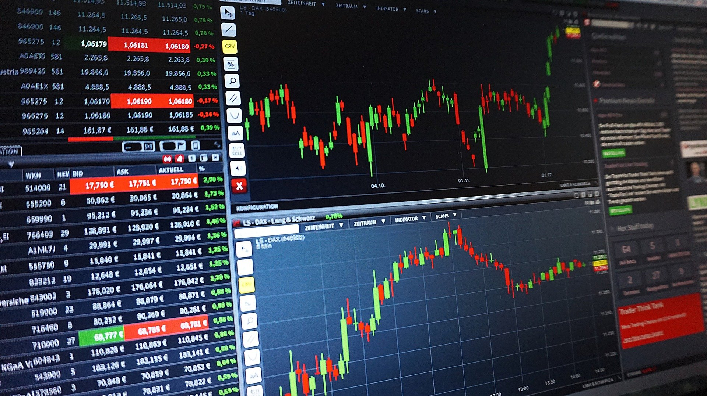
Introduction to Stock Market
What is Stock Market?
The stock market refers to public markets that exist for issuing, buying, and selling stocks that trade on a stock exchange or over-the-counter.
Stocks, also known as equities, represent fractional ownership in a company, and the stock market is a place where investors can buy and sell ownership of such Financial Assets.
An efficiently functioning stock market is considered critical to economic development, as it gives companies the ability to quickly access capital from the public.

Slide 4
Survey
Stock market is basically nonlinear in nature and the research on stock market is one of the most important issues in recent years. People invest in stock market based on a few prediction
For predict, the stock market prices people search such approach and tools which will increase their profits, while minimize their risks. Prediction plays a very crucial role in stock market business which is very complicated and challenging process.
Employing universal methods like fundamental and technical analysis may not ensure the reliability of the prediction. To make predictions regression analysis is used mostly. In this paper we survey of well known efficient regression approach to predict the stock market price from stock market data based. In future the results of multiple regression approach could be enhanced using more number of variables.

Slide 5
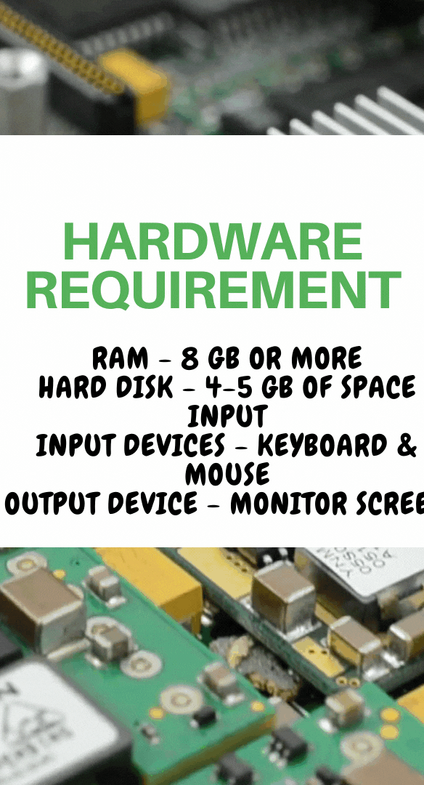

Technology Requirements
Hardware and Software Requirements

Slide 6


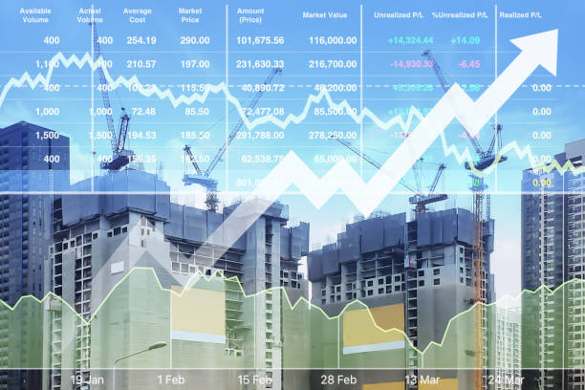
What is Stock market Prediction?
Stock Market Prediction's purpose is to estimate the future worth of a company's earnings via stocks.
Machine learning is a new occurrence in stock market forecasting approaches that provides forecasts founded on the principles of current stock indexes by training on their prior data.
To develop correct estimates, machine learning employs a range of products. The study focuses on predicting stock value using regression as well as other machine learning technologies.
The goal of Stock Market Prediction is to forecast the future value of a company's performance through stocks.
Machine learning is a novel event in share market forecasting methodologies that deliver projections based on actual stock index principles by training on their previous data.

Slide 7
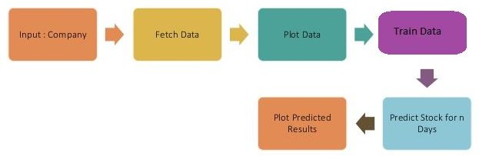
Working of Stock Market Prediction Works?
Stock market prediction is a computerized prediction method that highlights the danger that investors face while investing in stocks. It forecasts stock prices and currency rates while considering the user's basic knowledge and statistical analysis. Machine learning uses a variety of items to produce precise predictions. The research focuses on applying regression and other machine learning methods to predict stock value.

Slide 8
Special Features
This project aims for a collected data set, analysing it with Machine Learning Algorithms and generating output.
Various prediction algorithms are used to predict that are accurate and sufficient in the form to yield.
Keep track of progress and analysis of the results daily to determine the flow and degree of integration
Evaluating and implementing the results to support the actual situation

Slide 9

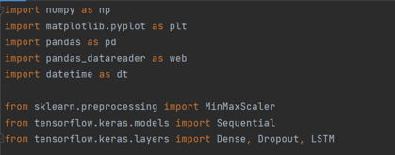
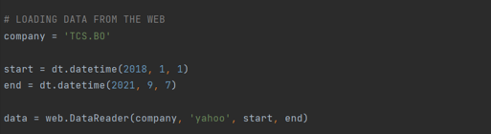
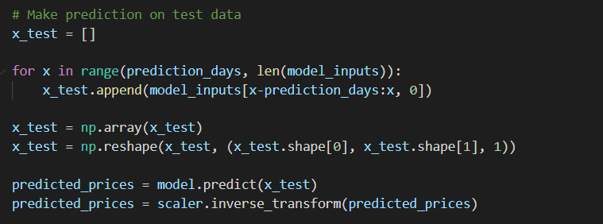
01
PYTHON LIBRARIES
CODE/SCREENSHOT
02
LOADING OF DATA
03
PREDICTION

Slide 10
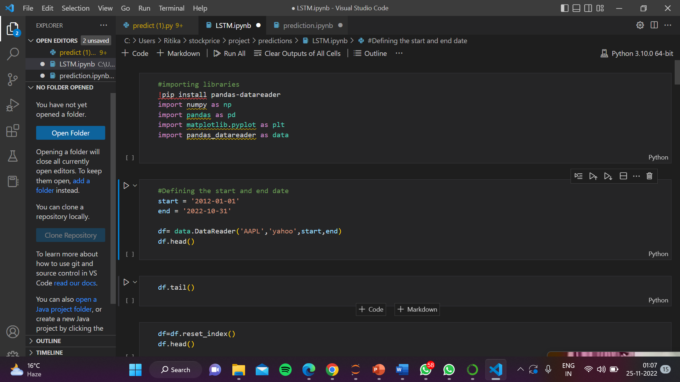
Here we are importing packages of python that are going to be used in the following code and loading the data from the web (yahoo).

Slide 11
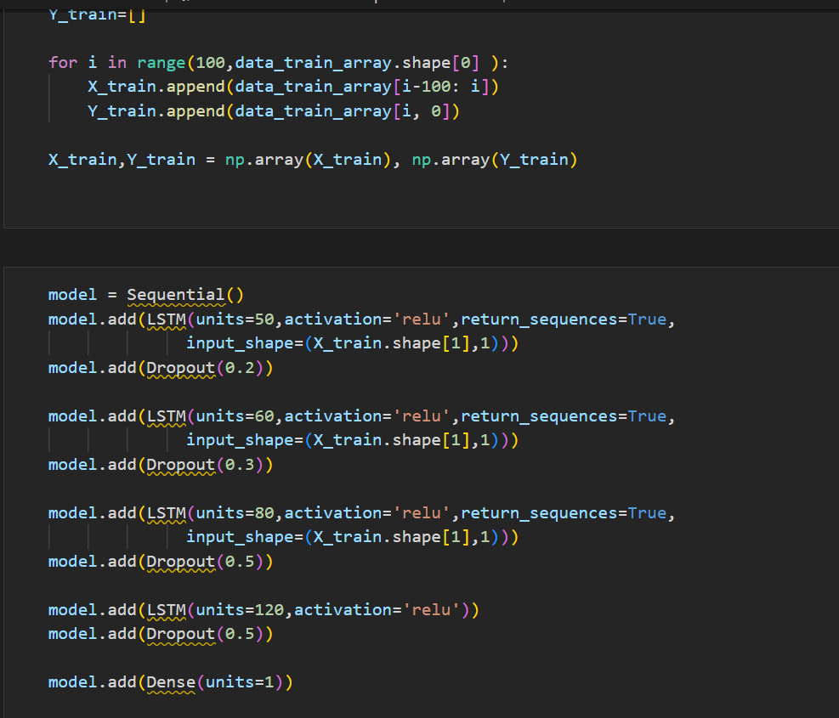
Here we are going to build the model for the graph and loading of the test data simultaneously.

Slide 12
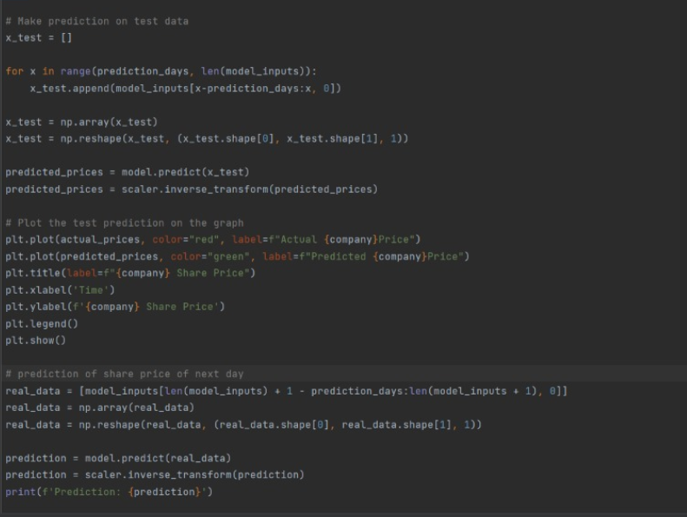
Here we are going to do the prediction on the test data that we have taken from the web.

Slide 13
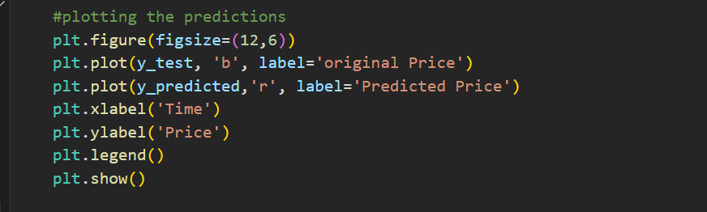
Here we are going to plot the test data prediction graph that includes ORIGINAL as well as PREDICTED prices of the stock.

Slide 14
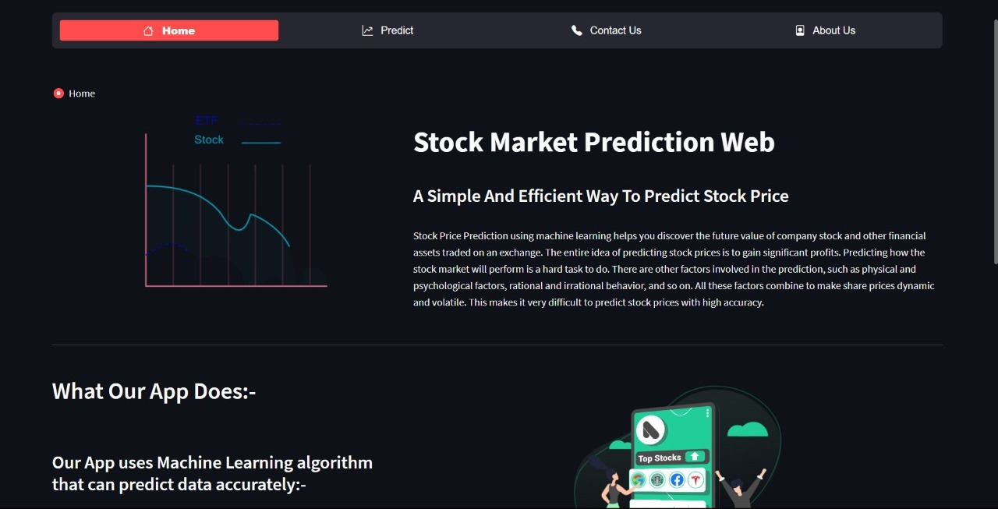

Slide 15
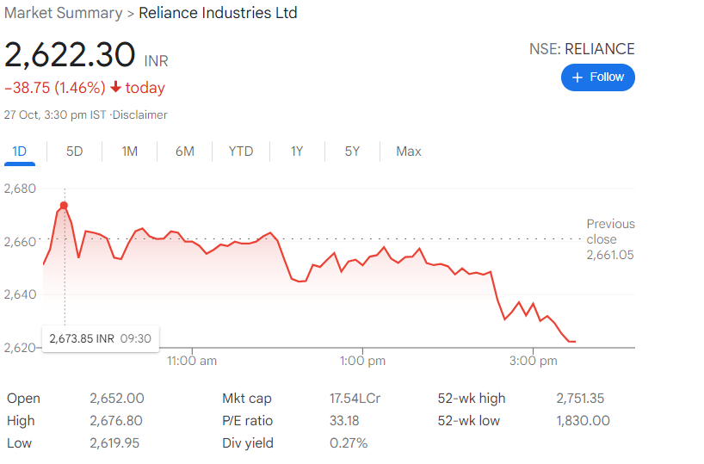
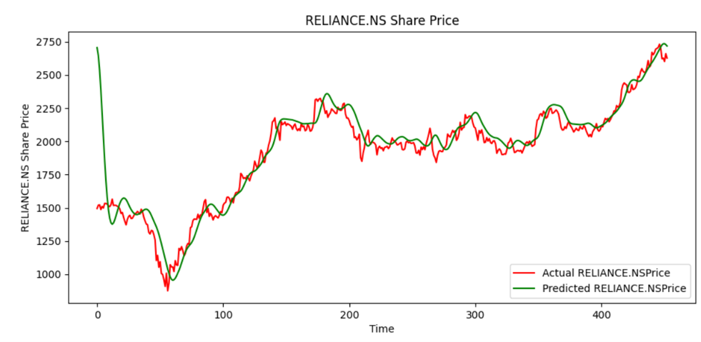
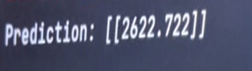
ACCURACY OF PREDICTION

Slide 16
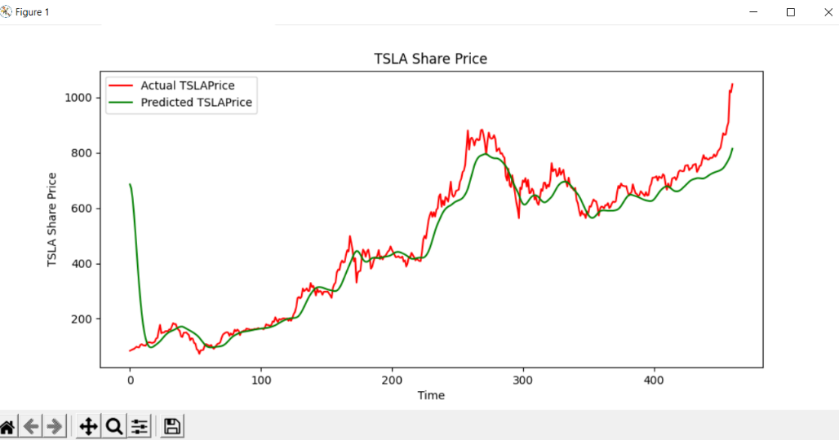
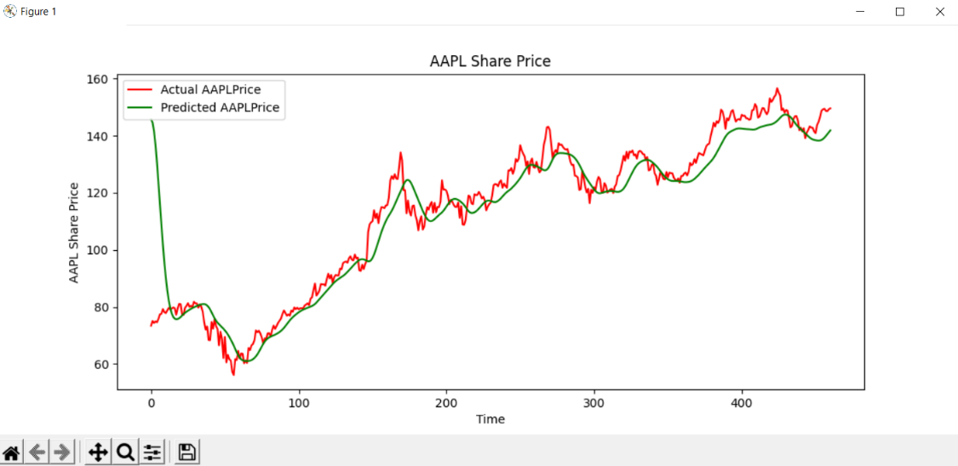
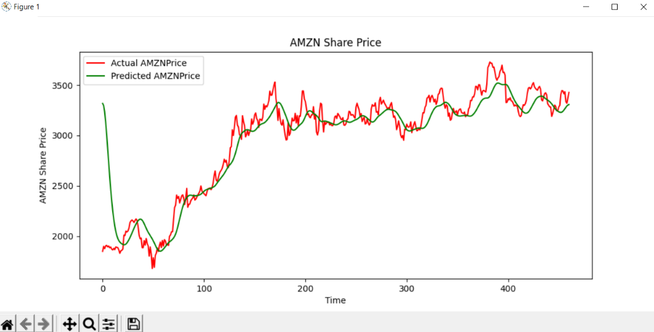
TESLA STOCK GRAPH
APPLE STOCK GRAPH
AMAZON STOCK GRAPH

Slide 17
FUTURE SCOPE
Future scope of this project will involve adding more parameters and factors like the financial ratios, multiple instances, etc.
The more the parameters are taken into account more will be the accuracy.
The algorithms can also be applied for analyzing the contents of public comments and thus determine patterns/relationships between the customer and the corporate employee.
The use of traditional algorithms and data mining techniques can also help predict the corporation performance structure as a whole.
In the future, we plan to integrate neural network with some other techniques

Slide 18
CONCLUSION
We have successfully implemented machine learning algorithms on the dataset for predicting the stock market price.
We applied data pre processing and feature selection on the dataset. We applied algorithm:, LSTM on the dataset.
We analysed the difference of the algorithms by calculating the performance metrics (accuracy, Recall, precision, f-score).
We also found the advantages and disadvantages of the algorithms.
Future scope of this paper would be adding more parameters that effect the stock market prediction. Adding more number of parameters will ensure better estimation.

Slide 19
REFERENCES
Shah D, Isah H, Zulkernine F. Stock Market Analysis: A Review and Taxonomy of Prediction Techniques. Int. J. Financial Stud., 2019, 7(2).
Zhong X, Enke D. Forecasting daily stock market return using dimensionality reduction. Expert Systems with Applications, 2017, vol. 67.
Hiransha M, Gopalakrishnan E A, Menon V K, Soman K P. NSE stock market prediction using deep-learning models. Procedia Computer Science, 2018, vol. 13.
Velay M, Fabrice D. Stock Chart Pattern recognition with Deep Learning. arXiv, 2018.
Parracho P, Neves R, Horta N. Trading in Financial Markets Using Pattern Recognition Optimized by Genetic Algorithms. 12th Annual Conference Companion on Genetic and Evolutionary Computation, 2010, pp. 2105-2106.

Slide 20
THANK YOU !!

